Slide 1
Information Security Tools
ENPM 685

Slide 2
Offense
Recon, Port Scanning, and Vulnerability Assessment

Slide 3
Phases of an attack
Reconnaissance – this week
Scanning – this week
Exploitation – next week/week after
Creating Persistence – next week/week after
Covering Tracks – an exercise left to the reader…

Slide 4


Slide 5
Goals of Scanning
Find potential targets and avenues for compromise
Locate hosts, firewalls, routers, security devices
Determine the network topology of target
Identify OS, open ports, and versions of applications running on a host

Slide 6
What’s the difference?
Vulnerability scanning
Vulnerability assessment
Vulnerability management
Enumeration

Slide 7
Vulnerability scanning
Just what it says, scanning systems looking for vulnerabilities
But then what?

Slide 8
Vulnerability assessment
Scanning systems for vulnerabilities
Determine the risk level of those vulnerabilities to determine:
If you should eliminate that vulnerability (patch or configuration change)
If you should mitigate that vulnerability (defense in depth)
Operational impact to eliminating or mitigating the vulnerability
Operational impact of doing nothing
Using this information to determine if you should patch/mitigate and priority level

Slide 9
Vulnerability management
Vulnerability assessment + patch management
Typically described as
Discover
Prioritize
Assess
Report
Remediate
Verify

Slide 10
Enumeration
Scanning a system and finding all useful information (port open, service details, etc.) to further the penetration tester’s goal of finding a way into a system

Slide 11
Recon
whois
DNS Zone Transfer
Google!
Google Dorking
OSINT

Slide 12
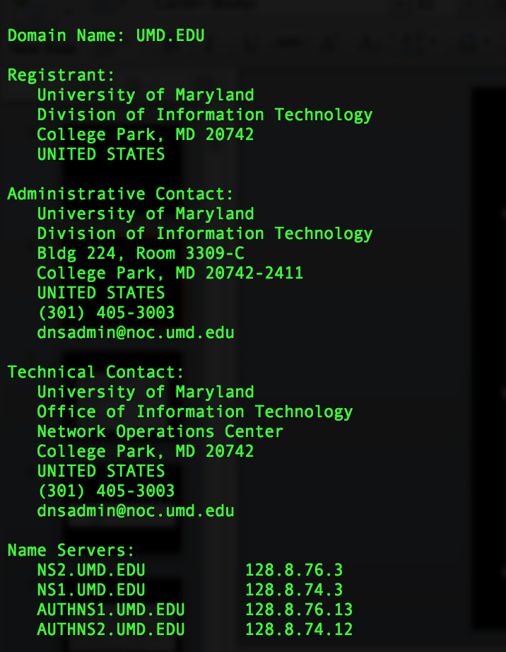
Recon
whois domain

Slide 13
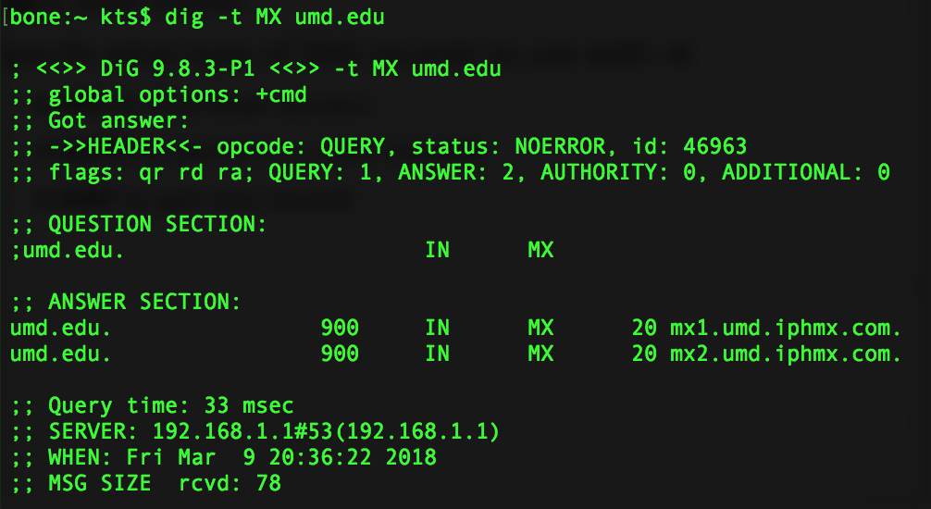
Recon DNS
dig is your friend.
Specify what type of DNS records to use with –t
Examples:
-t MX to find Mail Servers
-t AXFR to perform a zone transfer
-t ANY to get any record

Slide 14
Recon – DNS Zone transfer
dig domain axfr
May not always work, but worth trying since there is a lot of valuable information inside of it!
You may have noticed dig domain.com axfr works the same as dig –t AXFR domain.com

Slide 15

Recon – Google!
additional search terms site: domain

Slide 16
Recon – Google Dorking!
site: searches only within given domain
link: shows sites linked to a given site (doesn’t mix with other directives)
intitle: shows pages with matching title
inurl: shows pages whose URL matches
filetype: search for a specific type of file
htm/l, pdf, doc, xls, ppt, cgi, asp, php , etc.
Ex: site:umd.edu inurl:.php?id=
Ex: inurl:"8080/jmx-console"

Slide 17
Google Dorking Exercise – 10m
site: domain
filetype: doc, pdf, xls, aspx, php
inurl: something
intext: something
Mix and match, add options, remove options, experiment! (See exercise document for more examples)
Find something interesting!

Slide 18
Recon - OSINT
OSINT = Open Source Intelligence
Using Google, social media, mailing lists, etc. to find more information about your target
That target may be a organization or person
Learn about an organization’s
People
Culture
Technology
Infrastructure

Slide 19
Recon - OSINT
Search to find the target’s:
Major businesses
Products/services
Corporate officers or other VIPs
Competitors
Locations
Recent press releases

Slide 20
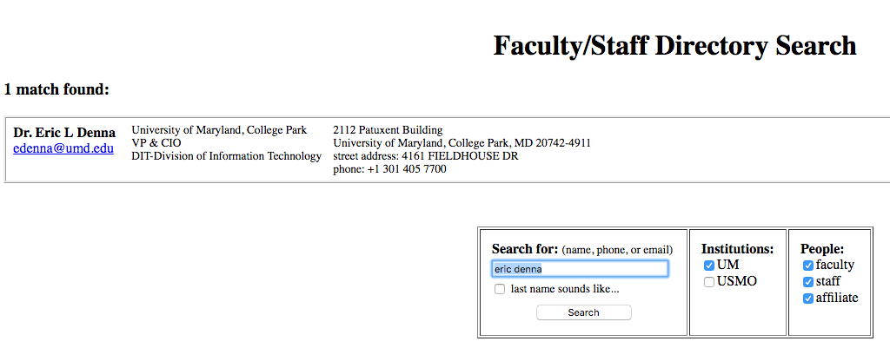
Searching for Useful People
Online directories for the target
Social networking sites (LinkedIn is great for this)

Slide 21
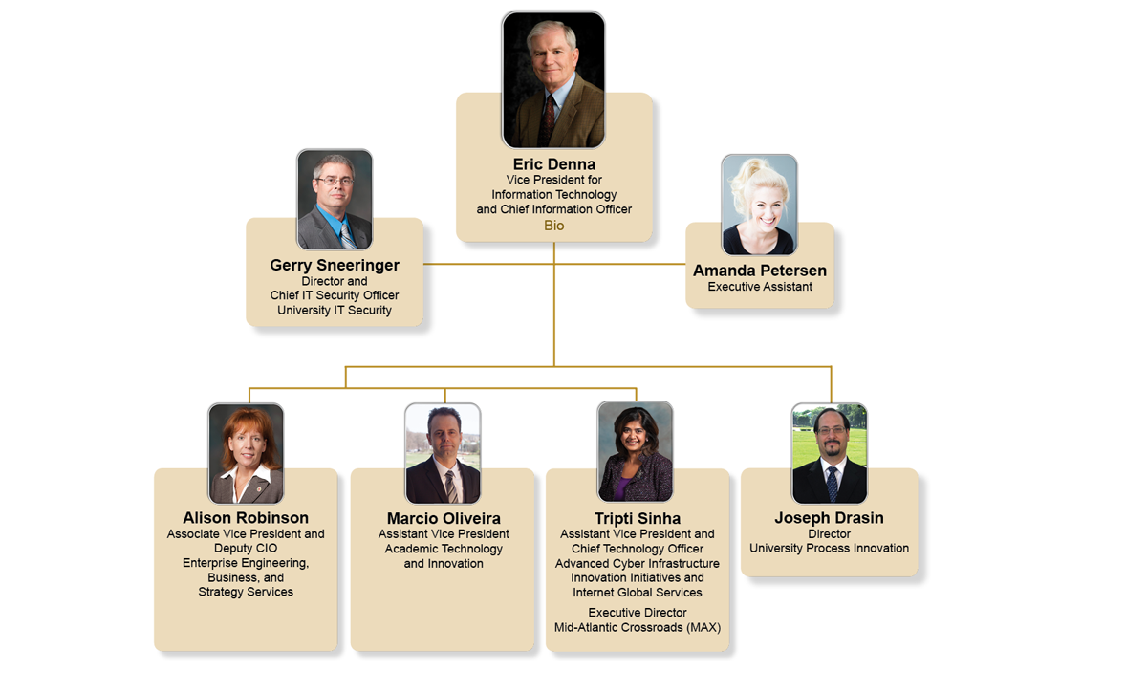

Slide 22
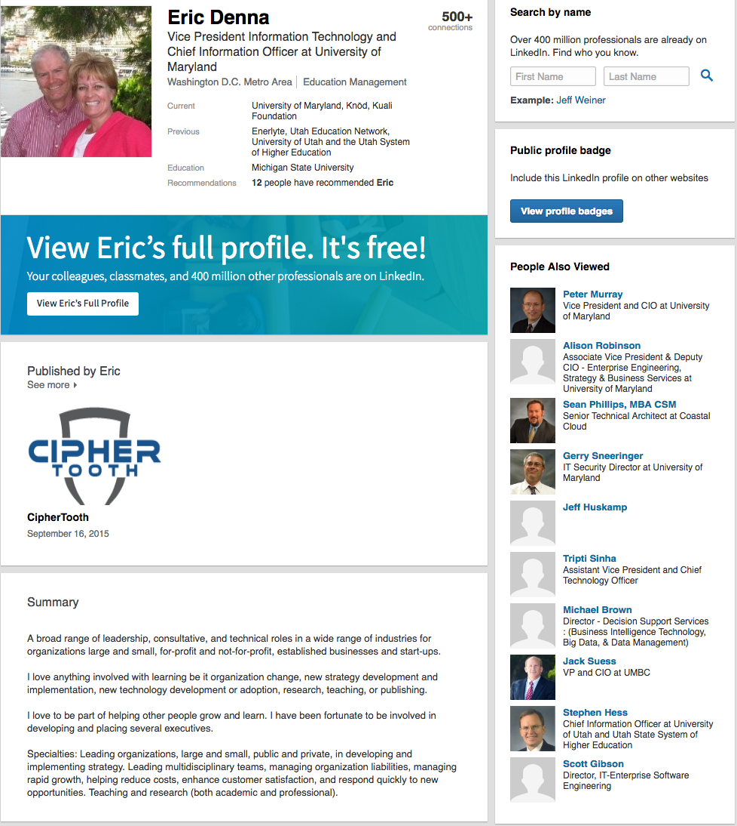
https://www.linkedin.com/in/ericdenna

Slide 23
Why is This Useful?
VIPs (and their entourage) are always useful for social engineering attempts
Get the VIP/entourage to provide info
Use their names, other people might provide more information, especially technical to be “helpful”
Do they have a technical background?
Find where they post online looking for help with technical problems

Slide 24
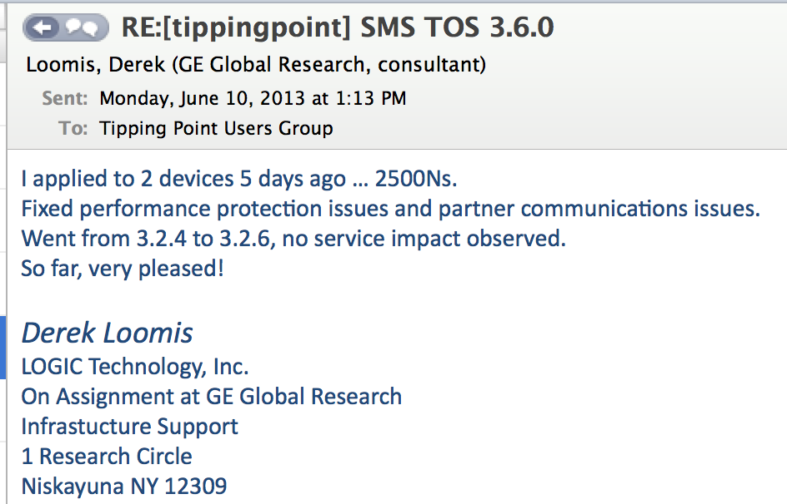
Recon - OSINT

Slide 25
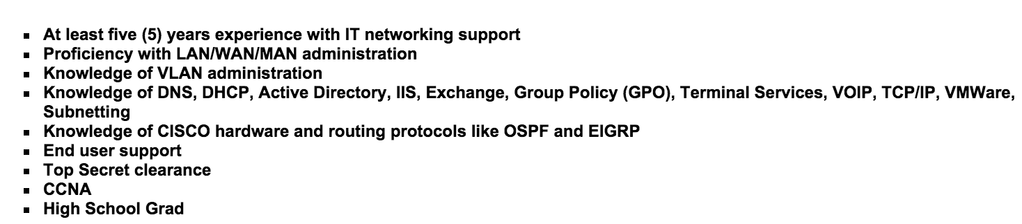
Recon - OSINT
Knowledge of DNS, DHCP, Active Directory, IIS, Exchange, Group Policy (GPO), Terminal Services, VOIP, TCP/IP, VMWare, Subnetting
Knowledge of CISCO hardware and routing protocols like OSPF and EIGRP
Top Secret clearance
CCNA

Slide 26
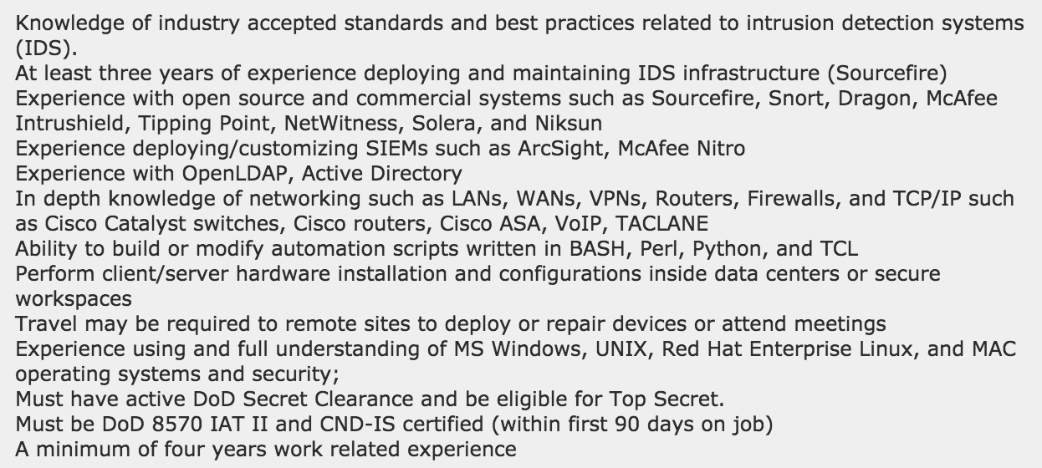
Recon - OSINT

Slide 27
PORT SCANNING IS NOT A CRIME!*
* Unless you live in Finland

Slide 28
Remember
I am not a lawyer

Slide 29
TCP and UDP Ports
From the Network Primer reading / prior knowledge:
TCP – connection-based
UDP - connectionless
Both use “ports”, 1-65535 possibilities
IANA keeps official list of reserved ports

Slide 30
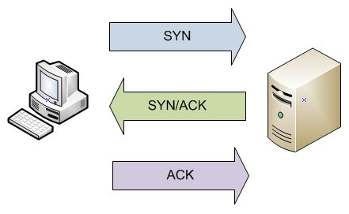
TCP: According to RFC 793…
If a system is listening on a TCP port and receives a SYN
That system will respond with a SYN-ACK
This is why port scanning works for TCP

Slide 31
Scanning UDP
Spray and pray
Much slower, mostly because you have to wait a while for a response
No good way to know if something is listening because it may not respond

Slide 32
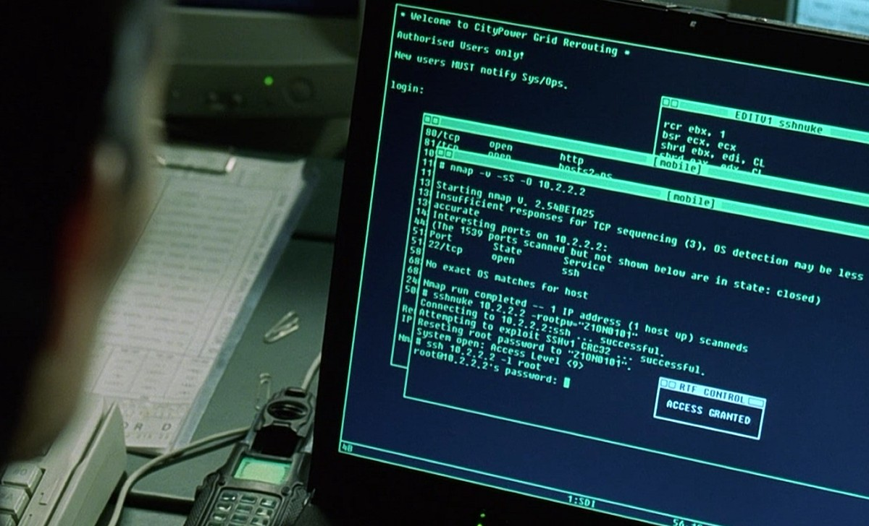
Nmap
The defacto standard tool for port scanning
First released in 1997 by Fyodor
Added OS Fingerprinting in 1998
Added service versioning in 2003
2007 – added Nmap Scripting Engine
Current version 7.92 (as of 12/2021)

Slide 33
Nmap for Network Mapping
By default Nmap pings each target address before scanning
To ID which IPs are in use Nmap first tries:
ICMP Echo Request (Ping)
TCP SYN to 443
TCP ACK to 80 (if running as root, SYN otherwise)
ICMP Timestamp request
This can be skipped/ignored with –Pn (used to be –P0)

Slide 34
Nmap Scan Types
-sT TCP Full Connect Scan
-sS TCP SYN scan (half open scanning)
-sU UDP Scan
-sA TCP ACK scan (useful for mapping firewall rules)
-sF TCP FIN scan (useful for mapping firewalls
-sN NULL scan (no TCP flags set)
-sX Xmas scan (FIN, PSH, URG set)

Slide 35
-sF –sN -sX
These work to exploit a loophole in how TCP works
If you send a packet that doesn’t have SYN, ACK, or RST flags set
Receive a RST back = port closed
No response = port open

Slide 36
Nmap – SYN scanning
-sS
Only send a SYN packet
Stealthy since you don’t open a full connection, often not logged on the host
Fast since you’re only sending a single packet
Default scanning method if running as root

Slide 37
Nmap – ACK Scanning
Supposed you want to allow outgoing connections but not incoming
You might configure a router or firewall to allow only established connections in (connection with ACK bit set)
This blocks session initiations from outside
But... an attacker can use an ACK scan to bypass
Can be helpful for network mapping

Slide 38
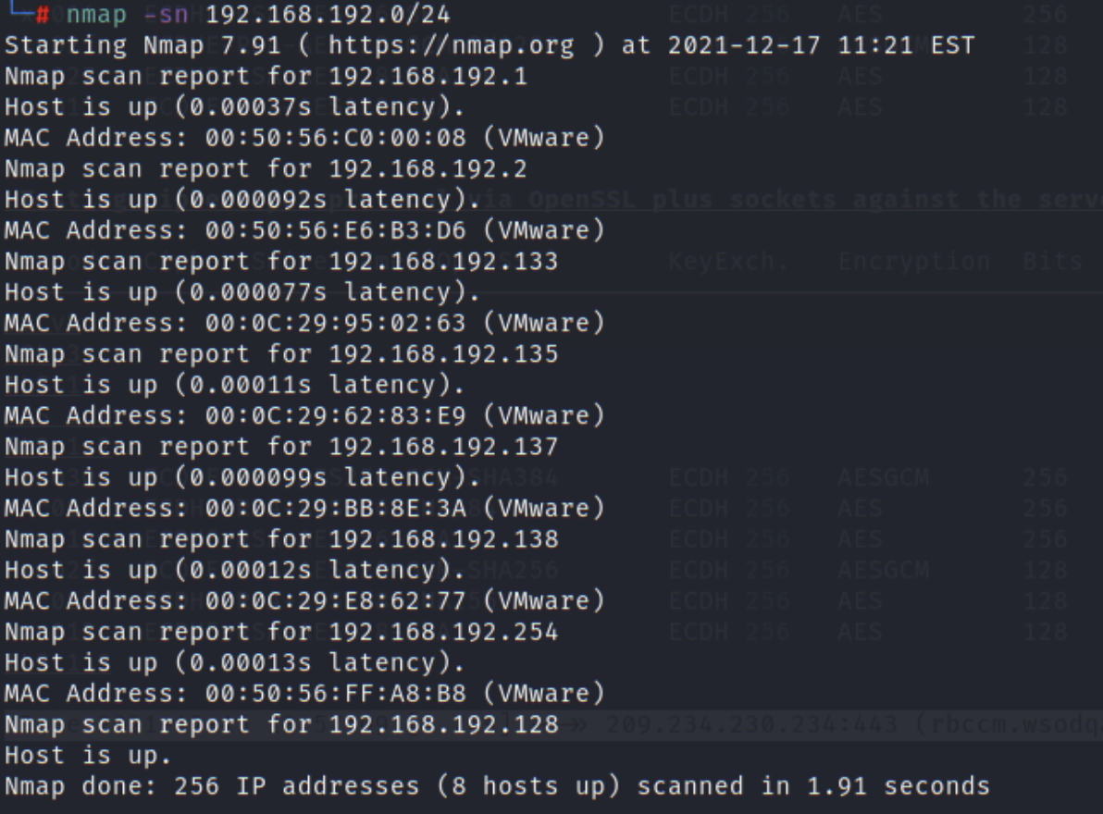
nmap –sn – Ping scan
Perform a ping scan of the network specified. Helpful for discovering systems on a network

Slide 39
Useful Source Ports for Scanning
By setting a specific source port you can often blend your scans in with legitimate traffic
UDP/TCP 53, TCP 80, TCP 443, TCP 22
Set with the –g option (or --source-port)

Slide 40
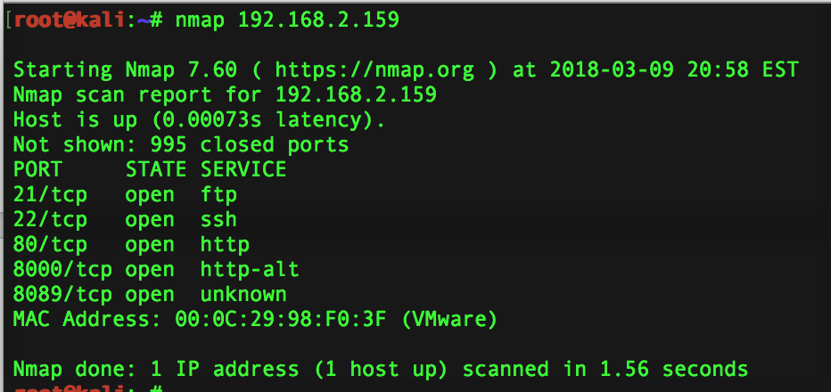
nmap

Slide 41
OS Fingerprinting
-O
Operating systems (and versions of OSes) have subtle differences in their TCP/IP stacks we can use to ID them
TCP ISN greatest common denominator and counter rate
TCP and ICMP IP ID sequence generation
TCP initial size window
IP initial TTL guess
And many more

Slide 42
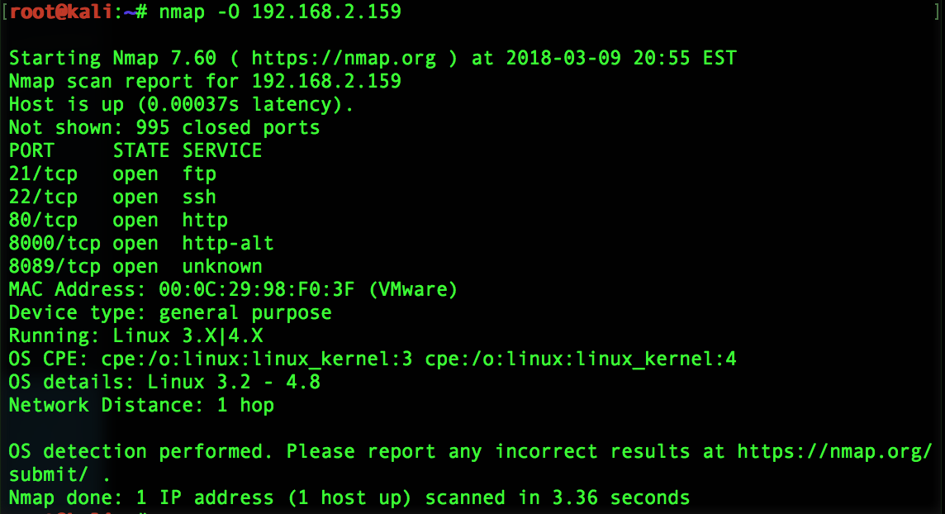
-O OS Fingerprinting

Slide 43
Version Scanning with Nmap
-sV
Provides more detailed info on a service running behind a port
Like banner grabbing but better
Helps ID service running on a non standard port
Helps build a potential list of vulnerabilities

Slide 44
How works
For every listening port discovered
Connect via TCP and listen for 5 seconds
Probes TCP and UDP ports sending data designed to elicit responses from a specific server (+1k service fingerprints by default)
Attempts SSL handshake on TCP and continues SSL probe if successful
Issues Null RPC commands to see if RPC services are in use

Slide 45
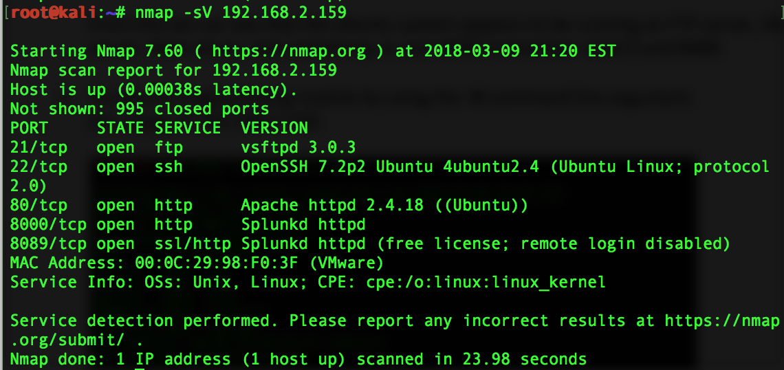
nmap -sV

Slide 46
nmap -A
OS Detection
Version Detection
Script Scanning
Traceroute

Slide 47
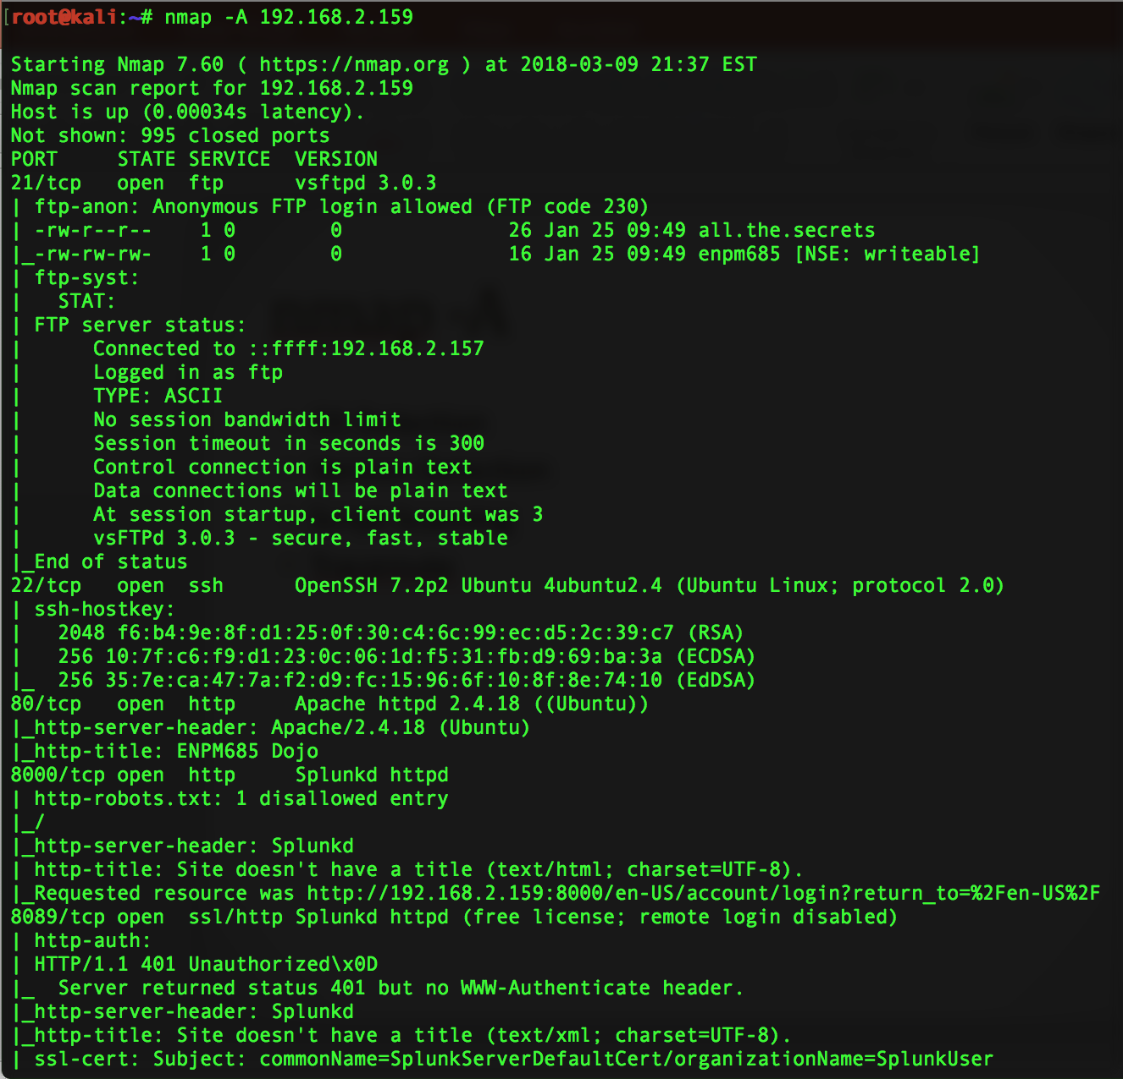

Slide 48
Nmap – other helpful arguments
-T (timing 0-5, 5 = super fast)
-p port or range = ports to scan
-p22
-p1-65535
-p U:53,111,137,T:21-25,80,139,8080
-6 = IPv6 scanning

Slide 49
Nmap - Input
List IP addresses, IP ranges, subnets, or host names at the end of the command
www.umd.edu
128.8.0.0/16 129.2.0.0/16
10.0.0-255.1-254
Or use –iL filename to take in a list from a text file

Slide 50
Nmap - Output
-oN file = normal STDOUT output to a file
-oG file = Grepable format
-oX file = XML
-oS file = s|<rIpt kIddi3 f0rm4t

Slide 51
Nmap Exercise – 20m
See exercise document - Scan your Ubuntu VM
Try some different options:
-sV
-O
-A
-p 1-10000
-sS , -sF, -sX
-oG file

Slide 52
Nmap runtime interaction
v – increases verbosity
p – turns on packet tracing
d – increases debugging level
[shift] + above key – inverts the action
Any other key will print a status message with elapsed time, hosts completed, # of hosts being scanned, % done, time to completion estimate

Slide 53
Nmap Scripting Engine (NSE)
Allows Nmap to send and receive arbitrary messages to multiple targets
Permits
Extended network discovery
More sophisticated version detection
Vulnerability scanning
Exploiting vulnerabilities
Written in LUA
nmap --script=[all,category,dir,script...] [target] -p [ports]
To update: nmap --script-updatedb

Slide 54
NSE Script Categories
Safe
Intrusive
Auth
Malware
Version
Discovery
Vuln
External
Default – includes scripts that are run when using –sC or -A

Slide 55
NSE Examples:
nmap –p 443 --script ssl-enum-ciphers host
nmap –p 22 --script “ssh*” host
nmap –p 135-139,445 --script smb-os-discovery host
nmap –p 80,443 --script “ssl-*,http-*” host

Slide 56
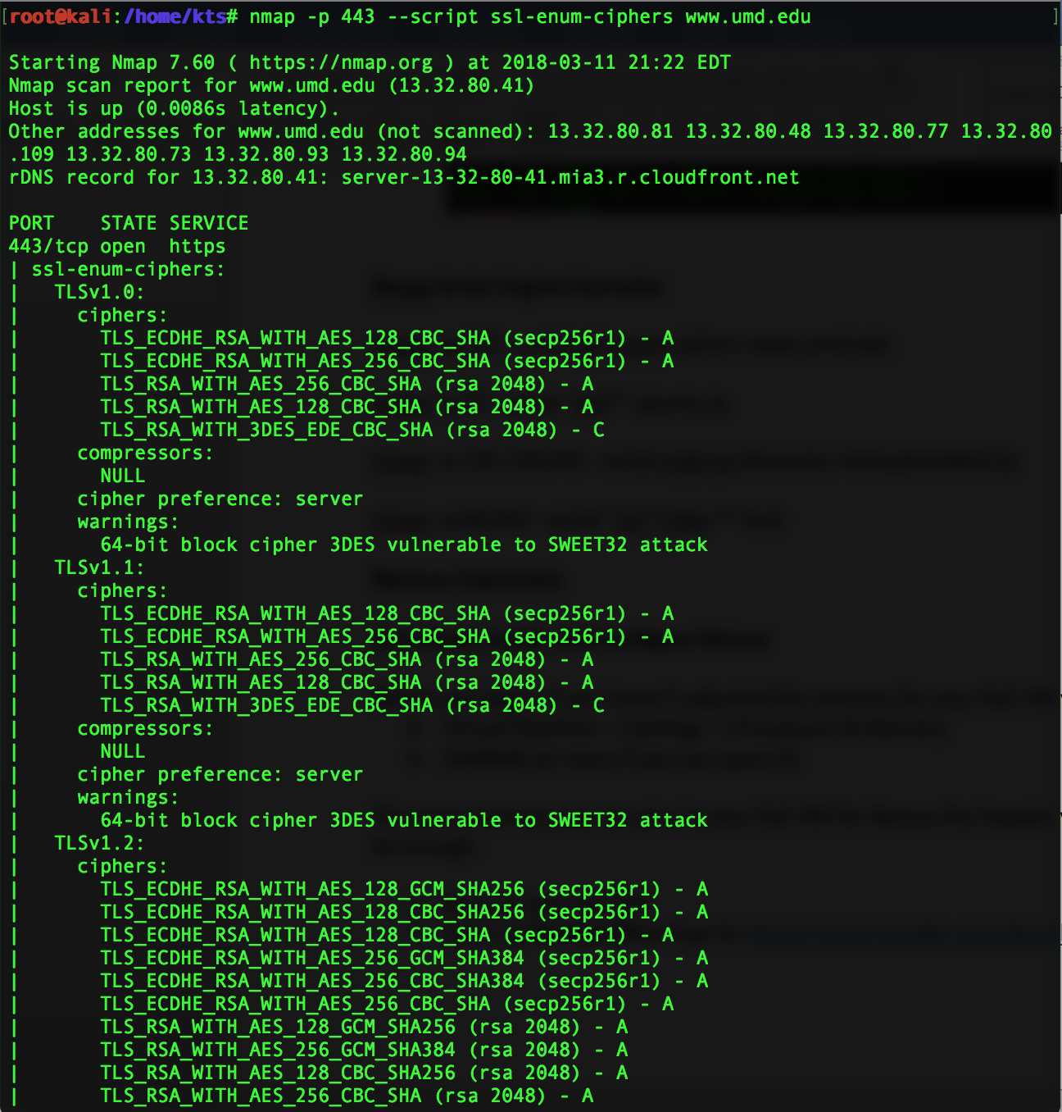

Slide 57
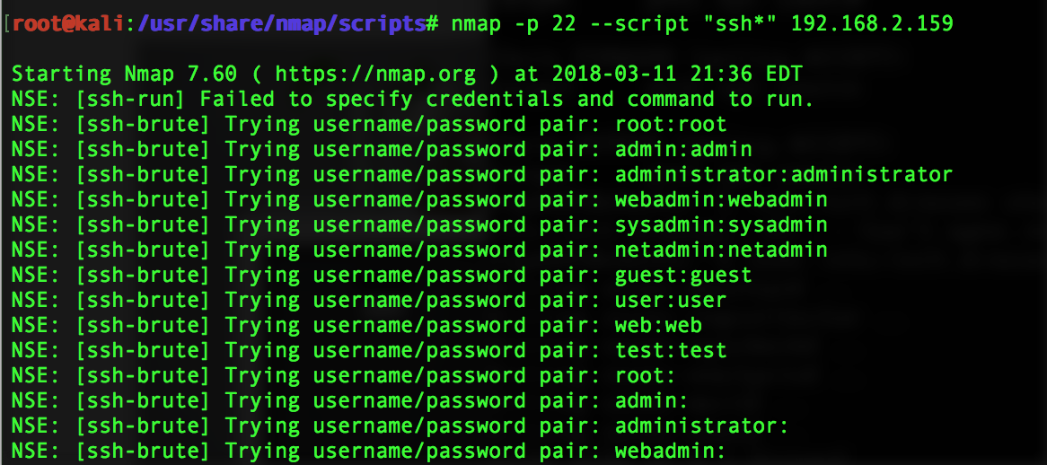

Slide 58
Masscan
Scan the entire world in only a few minutes (Assuming you have the speeds and feeds)
Uses PF_RING for speed
masscan 0.0.0.0/0 –p1-65535
https://github.com/robertdavidgraham/masscan

Slide 59
Pro Tips
Scan IP addresses, not hostnames
Round robin DNS, content switches, etc. could mess with results
Scan hostnames, not IP addresses
Virtual hosts/multiple hosts on same IP could mess with results
Large scans
Sample subset
Sample target ports
Go back for in-depth scanning on select hosts/nets later
Where you can from matters
Scan from inside/outside/different subnets if you can

Slide 60
Vulnerability Discovery Process
In escalating intrusiveness:
Checking banner/software version number
Checking protocol version number spoken
Looking at behavior based on what you poke
Checking configurations based on poking
Running an exploit against it

Slide 61
Vulnerabilities
Not all vulnerabilities are exploitable.
Some may provide information leakage (still bad) but not a way for an attacker to run commands on the system.
Some vulnerabilities can be due to a misconfiguration (ex no firewall, allowing root SSH logins, and a password of “password”) but are not actually exploiting a bug in a specific piece of software

Slide 62
Vulnerability Scanners
Can help map a network, scan for open ports, get service versions and find vulnerabilities
Can also generate pretty reports to give to boss-types

Slide 63
Where to scan from?
As close to the system you want to scan as you can get.
Why?

Slide 64
Where to scan from?
Outside the border of your network.
Why?

Slide 65
Where to scan from?
Final answer: as many places as you realistically can.
Why?

Slide 66
What to scan?
Scan the most important things
Systems that are critical to your organization functioning
System that process PII
Scan servers, systems of VIPs & those who process sensitive information
Everything else

Slide 67
Why not scan everything?
Do you enjoy reading 6,058 page reports?
Report fatigue is a real thing.

Slide 68
What do you fix first?
10.4.20.15 – 2,000 vulnerabilities (average CVSS – 7)
10.37.18.9 – 1 vulnerability (average CVSS 10)
10.250.8.43 – 10 vulnerabilities (average CVSS 5.8)

Slide 69
How about now?
Printer – 2,000 vulnerabilities (average CVSS – 7)
Mission Critical Server – 1 vulnerability (average CVSS 10)
CEO’s Desktop – 10 vulnerabilities (average CVSS 5.8)

Slide 70
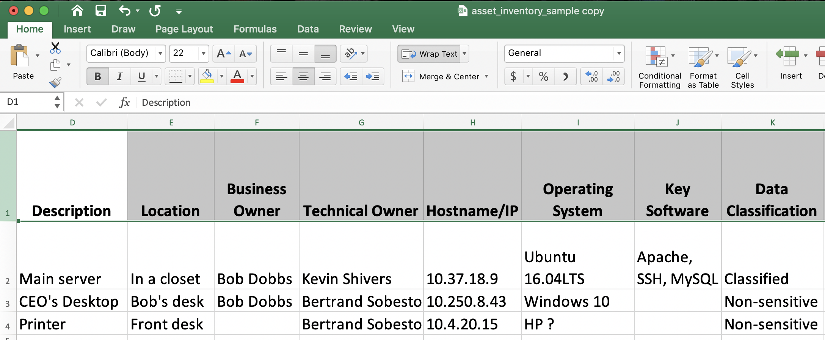
How do you correlate that?

Slide 71
False Negatives
When a system is vulnerable but the scan does not detect/report that it is.
Typically due to:
A poorly written check
Something that can not be detected remotely or with the credentials provided
Hard to trigger without putting the system in an unstable state

Slide 72
False Positives
When a system is reported to be vulnerable but it actually is not.
Typically due to:
Going off banner version information and no further checks
Vendors back porting patches
Poorly written check
Doing an un-credentialed/agent based scan

Slide 73
Backporting of Patches
"The Apache server version installed is 2.4.18. The latest version, as of October 2021, is 2.4.51."
Many Linux distributions are big into "back porting" patches.
This is where the Linux distro updates the code to fix a vulnerability but don't update the version string, or if they do it's with something like 2.4.18-ubuntu-patch1482

Slide 74
Backporting of Patches
Red Hat’s explanation of why: https://access.redhat.com/security/updates/backporting
Red Hat provides version 5.3 of PHP in Red Hat Enterprise Linux 6. The upstream version of PHP 5.3 has reached the end of life on August 14, 2014... on October 14, 2014, a buffer overflow flaw CVE-2014-3670 … [was] discovered in PHP that could allow a remote attacker to … execute arbitrary code with the privileges of the user running that PHP application.

Slide 75
Backporting of Patches
Because version 5.3 of PHP has been retired upstream, the fix for this issue was not provided in an upstream release of PHP 5.3. The only way to mitigate the issue would be to upgrade to PHP 5.4, which did provide a fix for CVE-2014-3670. However, Red Hat customers using PHP 5.3 may not be able to migrate to PHP 5.4 due to possible backward compatibility problems between versions 5.3 and 5.4. …
For this reason, Red Hat provided (backported) the fix for this issue to the PHP 5.3 packages shipped with Red Hat Enterprise Linux 6 so that customers could keep using PHP 5.3 and would mitigate CVE-2014-3670 at the same time.

Slide 76
Backporting of Patches
Customers need to be aware that just looking at the version number of a package will not tell them if they are vulnerable or not. For example, stories in the press may include phrases such as "upgrade to Apache httpd 2.0.43 to fix the issue," which only takes into account the upstream version number. This can cause confusion as even after installing updated packages from a vendor, it is not likely customers will have the latest upstream version. They will instead have an older upstream version with backported patches applied.
Also, some security scanning and auditing tools make decisions about vulnerabilities based solely on the version number of components they find. This results in false positives as the tools do not take into account backported security fixes.

Slide 77
Backporting of Patches
This is really annoying
This is also where your asset inventory is helpful to reduce false positives
You do have an accurate asset inventory right?

Slide 78
Vulnerability Scanners – Big 4
Tenable’s Nessus ($ and free)
Rapid7’s Nexpose ($ and free)
Qualys ($, cloud based)
OpenVAS (free)

Slide 79
Nessus
Created in 1998 by Renaud Deraison
Was originally open source, went closed source in 2005
$ for up to date feed, free for home use but a delay in getting updated plugins/checks
Currently on version 10.x
https://nessus.org/
Commercial version – Tenable - https://www.tenable.com/
NASDAQ: TENB

Slide 80
Nessus
Client/Server app (used to be a GUI app, now is a web app)
Client and server can run on same host (typical config)
Runs on port 8834 by default
Uses “plugins” to do vulnerability checks
Plugins written in NASL – C-like

Slide 81
Nessus Plugins
There is an API for writing plugins that do checks for a specific vulnerability
Written in NASL, a C-like language
Currently ~80,000 plugins (June 2016)
~51 categories of plugins

Slide 82
Nessus Plugins
Typically split into major services (DNS, FTP, CGI/web app, XSS, RPC)
But also many local checks for a variety of OSes (Windows, FreeBSD, RedHat, and network gear (Cisco, Palo Alto, Juniper)
Specific category for Windows Security Updates
“General” “Misc” “SCADA” etc

Slide 83
Nessus Plugins
For the most part each plugin does one test for one specific vulnerability
Plugins can make use of other plugins/functions of those plugins and store information in a shared knowledge base

Slide 84
Dangerous Plugins
Some checks are “dangerous” in that they could crash the remote host or lock out accounts
Denial of Service attacks too
“Safe checks” is the option that turns off dangerous plugins
“Safe checks” turned on by default

Slide 85
You could go to jail/get fired warning
GET YOUR PERMISSION TO DO THIS TYPE OF SCANNING IN WRITING FIRST!!!

Slide 86
Nessus Plugins
Update early and often (especially before a big scan)
Set up to be automatic by default and done every 24 hours with a registered update feed
Run ‘nessus-update-plugins’ manually

Slide 87
Nessus Results
Results include
Risk level estimate
Description of the issue
Recommended solution
Results not 100% guaranteed

Slide 88
Reporting
Don’t just hand a user the PDF out of your scan tool, only jerks do that.
Do some manual verification and review
Scanners focus on latest and greatest for everything – not always best
Provide a better explanation for the end user
Give focus on where end user should prioritize

Slide 89
Nessus Exercise – 30 minutes
Hopefully you already installed Nessus but if not start the “Download, Install, and Configure Nessus” section of Homework #1
If you have installed Nessus than dive into the “Scanning with Nessus” section

Slide 90
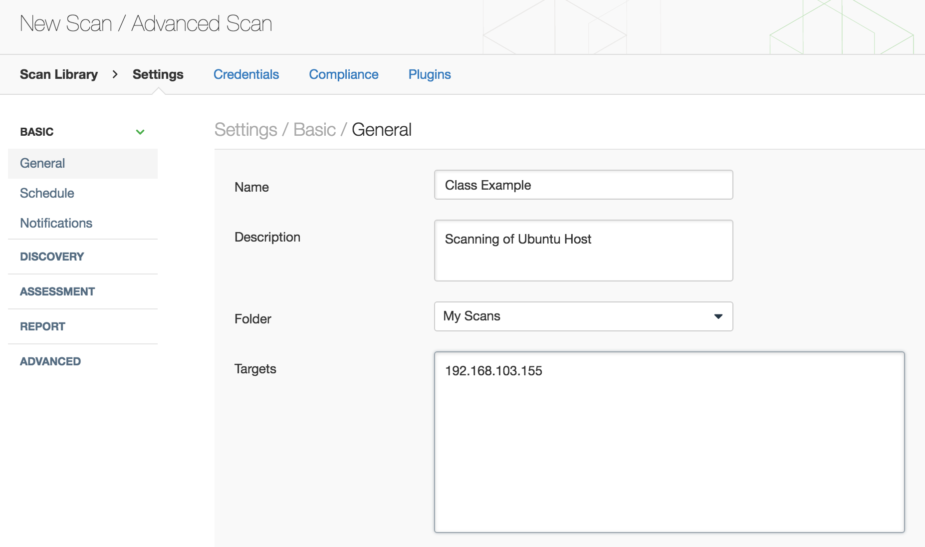

Slide 91
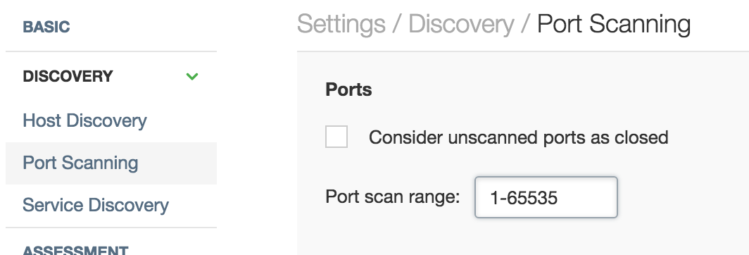

Slide 92
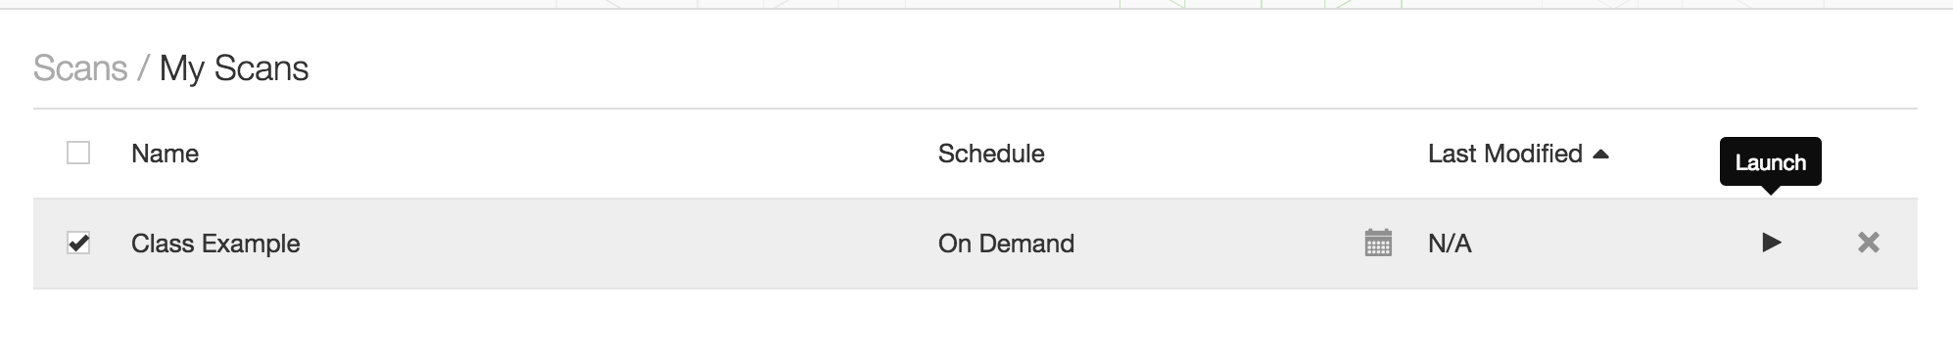

Slide 93
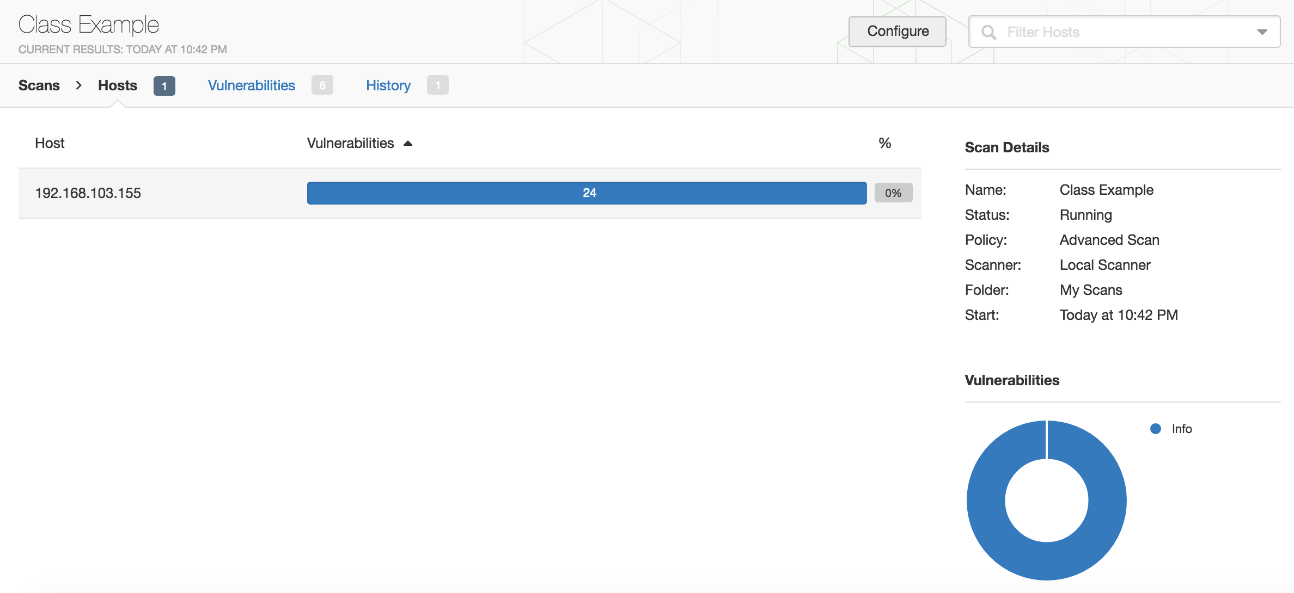

Slide 94
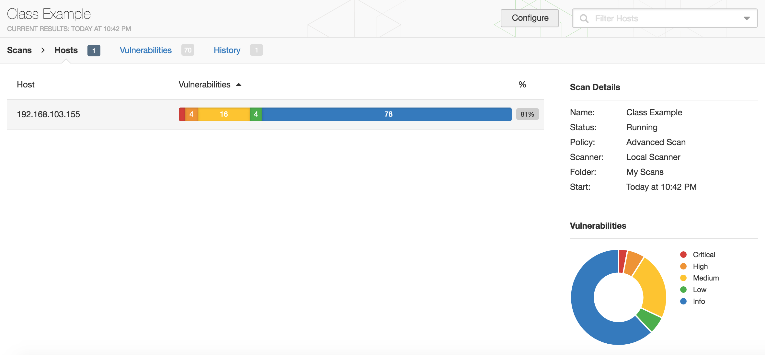

Slide 95
Web App Scanners
Automates looking at web sites/apps for known vulnerable issues
Old versions
SQL injection
Auth bypass
Command injection

Slide 96
Examples
Nikto
Whisker
w3af
Burp Suite
NetSparker
NetSparker
Rapid7 insightAppSec
Acunetix
AppScan (IBM)
HP WebInspect
Detectify
Qualys Web Application Scanning
…and many more…

Slide 97
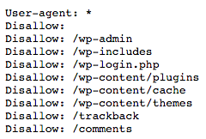
A quick word on robots.txt
A great place to find interesting files/directories
Disallow = some of the first places to check

Slide 98
Nikto
Written by Chris Sullo
Looks for
Default pages/settings
Well known server issues
Outdated versions of programs/servers
Over 6700 known dangerous files/programs

Slide 99
Nikto Features
Auto Update
Attempts to determine “OK” vs ”Not Found” messages for targets
Searches for and IDs things like CGI directories
Looks for robots.txt and checks things found there
Simple portscan (can integrate w Nmap too)
Can use LibWhisker for IDS evasion

Slide 100
Nikto Auth and Communucation
Supports web auth (Basic Auth or NLTM)
Grabs and stores any cookies received
Supports a proxy with or w/o auth
SSL Support
Supports user-defined plugins written in Perl
Mutation functionality
Sends requests using all combos of user-defined directories as well as discovered directories
Generates enormous amounts of traffic

Slide 101
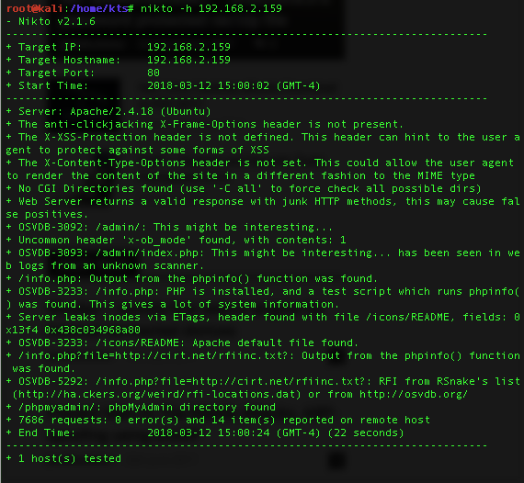
nikto –h ubuntu.ip

Slide 102
Nikto results (on Ubuntu VM)
/info.php = PHP info file
/admin exists (possible admin web UI?)
While you could check these things manually this does speed things up significantly.

Slide 103
WPScan
wpscan.org
Written in Ruby
Included with Kali Linux
wpscan –update
wpscan –r –u URL
wpscan –r –u URL --enumerate

Slide 104
WPScan Demo
wpscan –update
wpscan -u http://msmc.umd.edu

Slide 105
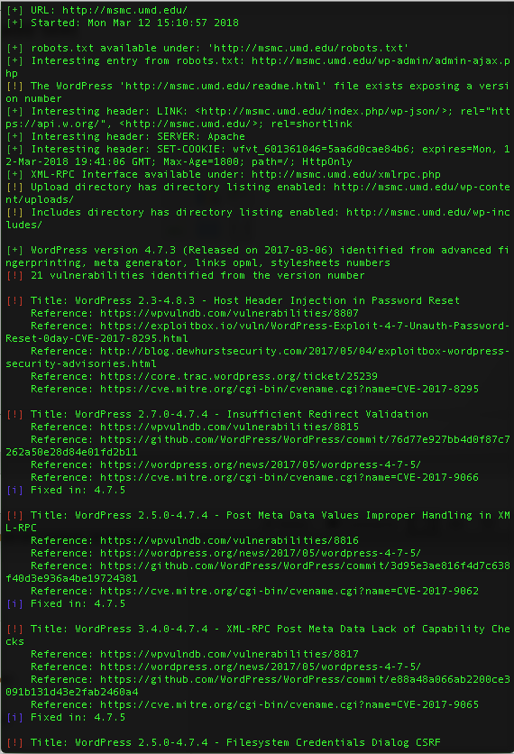

Slide 106
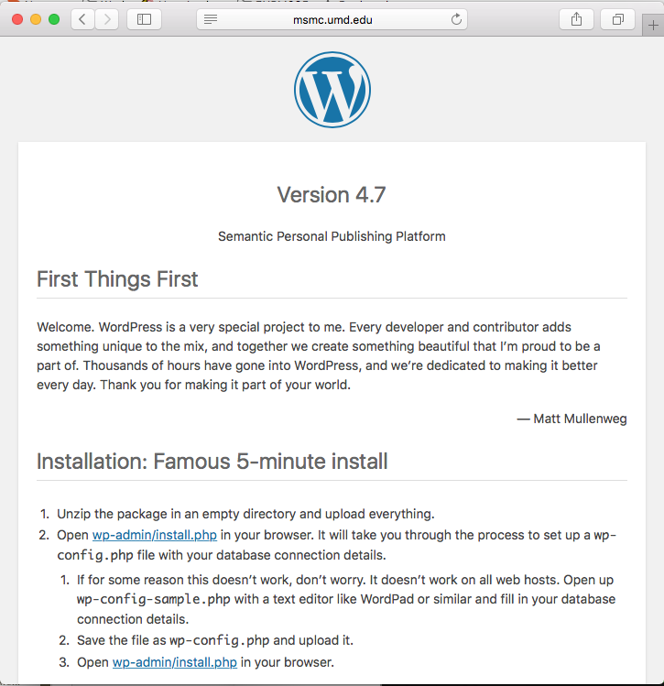
http://msmc.umd.edu/readme.html

Slide 107
Homework #2
Part 1 – Google-Fu / OSINT-Fu
Do some searching and submit the answers
Part 2 – Vulnerability Scanning
Scan your Ubuntu VM with a credentialed scan, compare with your uncredentialed scan from class and interpret the results

